Slide 1
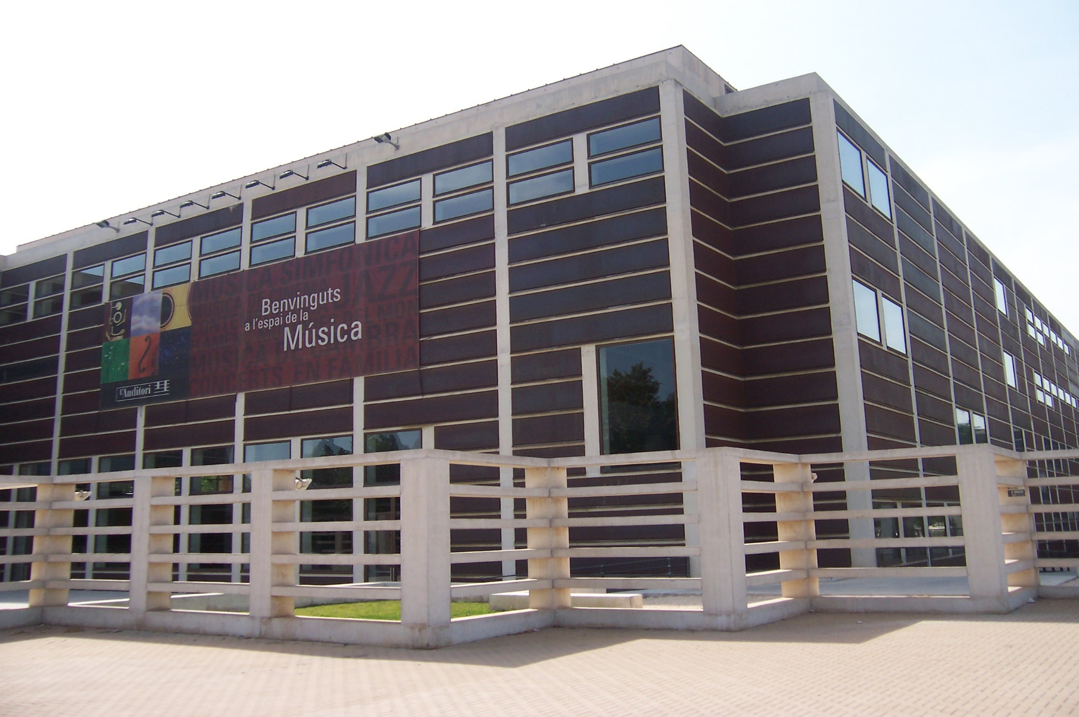


TUTTI FAN PIU

Slide 2
General Information
In this dossier you will find information about the concert you have come to see.
The material in this guide has been created as an anticipation tool to help you follow the concert.
Please note that the session you will attend is a family or school session, so there will be ambient noise in the hall due to the large number of children attending.
There are some moments when a strong spotlight shines towards the audience, at the beginning of the concert and during the sixth song.
To get to know the Auditori from the inside and find your way around, you can consult the general access dossier.
The pictographic symbols used are the property of the Government of Aragon and have been created by Sergio Palao per ARASAAC (http://arasaac.org) who distributes them under a Creative Commons license (BY-NC-SA). Author: CRAB Foundation and Aprenem Autisme.

Slide 3

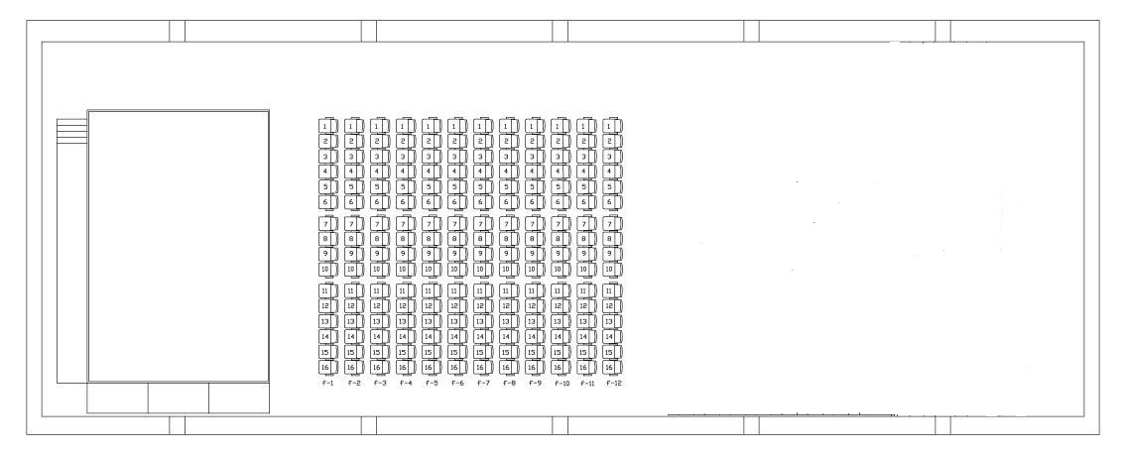
Hall 3 Map: Tete Montoliu
TOILETS
ACCESS
STAGE
The pictographic symbols used are the property of the Government of Aragon and have been created by Sergio Palao per ARASAAC (http://arasaac.org) who distributes them under a Creative Commons license (BY-NC-SA). Author: CRAB Foundation and Aprenem Autisme.

Slide 4

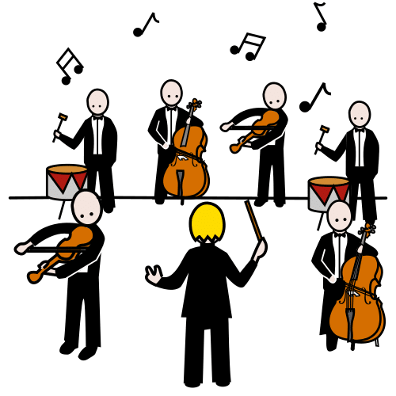



TODAY I AM GOING TO THE AUDITORI TO SEE THE TUTTI FAN PIU CONCERT.

Slide 5

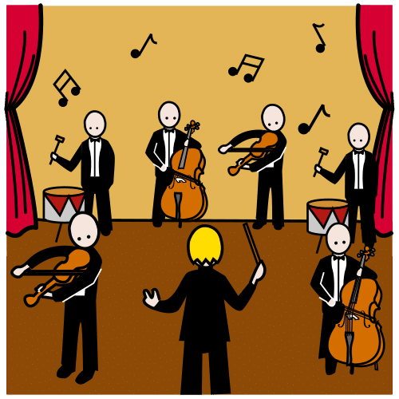
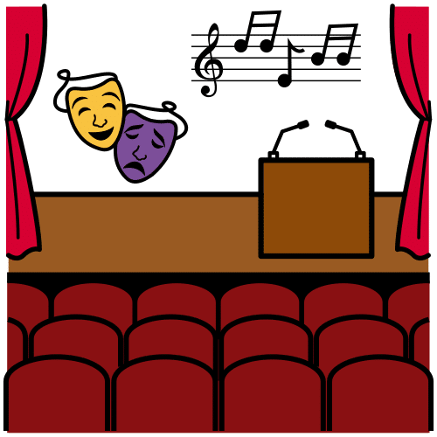
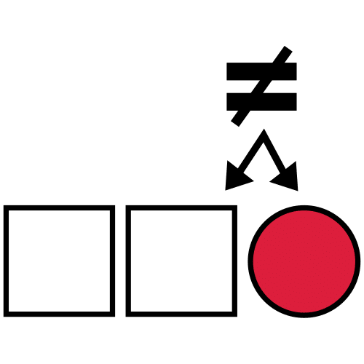

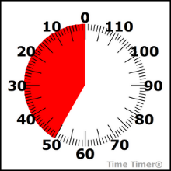


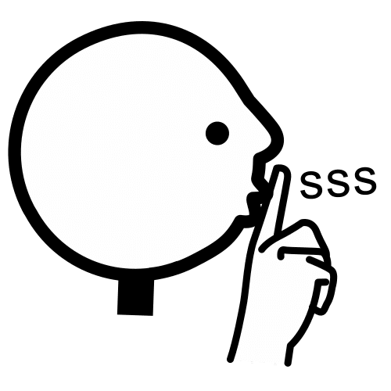
CONCERT INFORMATION
MUSIC CONCERT | DIFFERENT MUSICIANS ON STAGE
DURATION | 45 MINUTES
I | LISTEN AND WATCH IN SILENCE

Slide 6


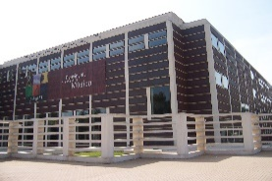
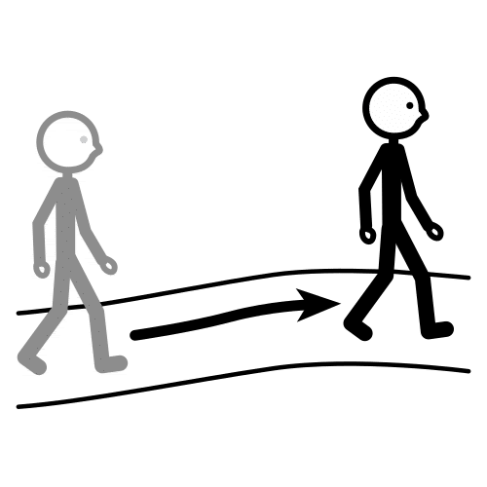
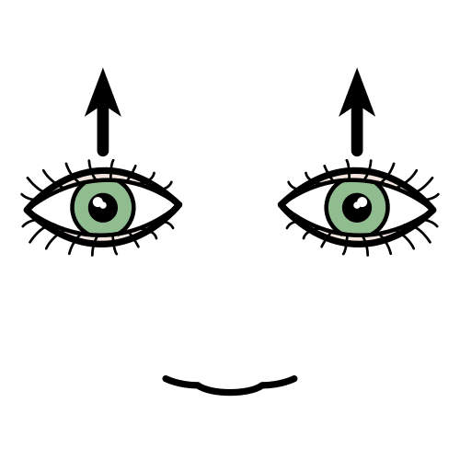


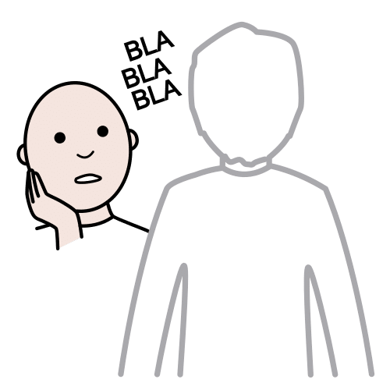


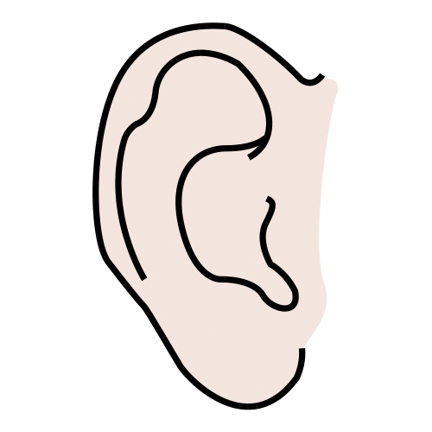
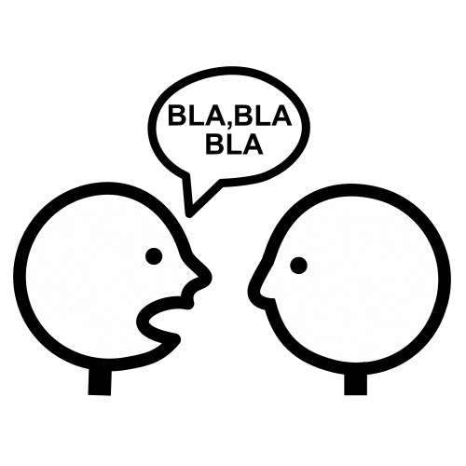
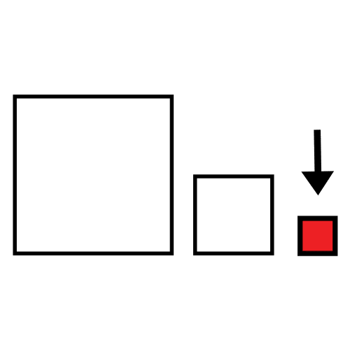


AUDITORI RULES
INSIDE THE AUDITORI I WALK.
EYES OPEN TO WATCH THE WHOLE CONCERT.
EARS ATTENTIVE TO LISTEN WELL.
MOUTH SMALL — IN SILENCE OR I SPEAK SOFTLY.

Slide 7
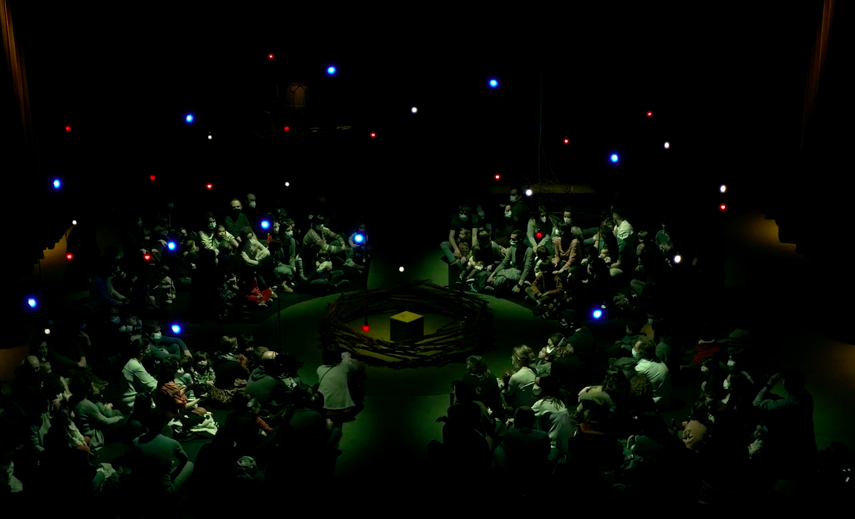
I ENTER THE HALL, SIT ON THE FLOOR AND WAIT FOR THE CONCERT TO BEGIN.

Slide 8
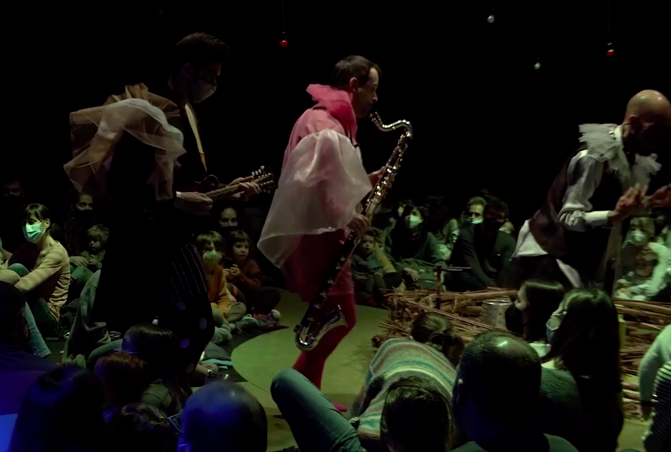
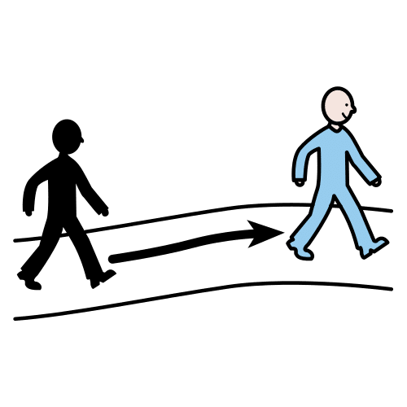

AT THE CONCERT, THE MUSICIANS PLAY THEIR INSTRUMENTS AMONG THE AUDIENCE.

Slide 9

THIS GUIDE WAS CREATED BY
The pictographic symbols used are the property of the Government of Aragon and have been created by Sergio Palao per ARASAAC (http://arasaac.org) who distributes them under a Creative Commons license (BY-NC-SA). Author: CRAB Foundation and Aprenem Autisme.

